Slide 1
PROJECT MAKAAN
Property Price Prediction
Presented by
Sneha Sawant
Mentor
Mr.Bose
Top Mentor

Slide 2
About Dataset:
This dataset was scraped from one of the housing website called as makaan.com. Makaan.com has quickly emerged as the preferred partner for consumers looking to rent, buy or sell a home. Makaan.com offers its online consumers maximum property options and has become one of the largest advertising platforms in online real estate in India.

Slide 3
Problem Statement:
The company wants to predict prices of various properties that will be listed in their site using Machine Learning Models. Based on the past data given to us, we need to predict the price.

Slide 4
Data pre-processing:
Data Cleaning steps:
Checking and removing special characters.
Data Type conversion.
Check for Duplicates
Drop the duplicate/irrelevant column and unnecessary columns.
Null Value Treatment - Identifying and imputing missing values.

Slide 5
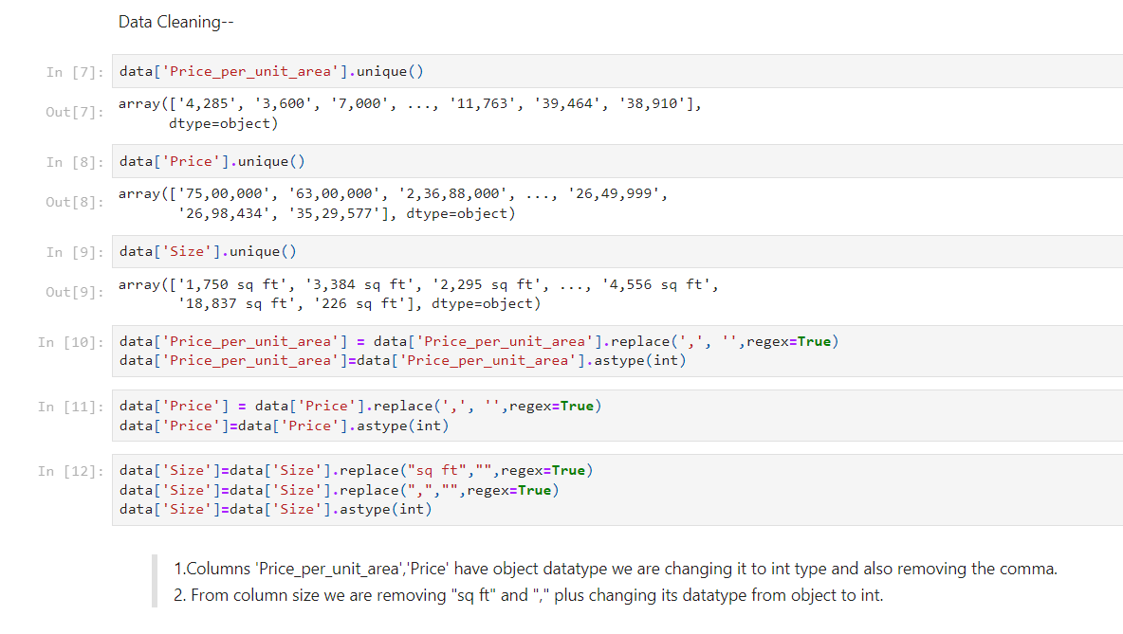
Data Cleaning: We observe some of the variables have incorrect datatype so we rectify those variables with the correct datatypes.

Slide 6
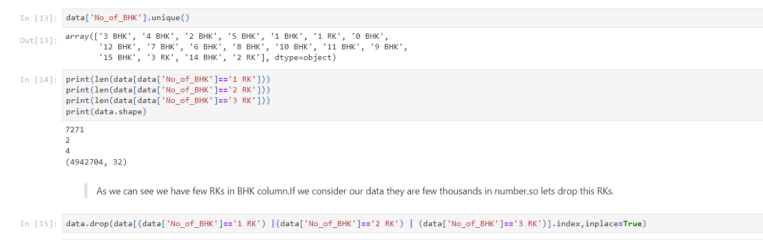
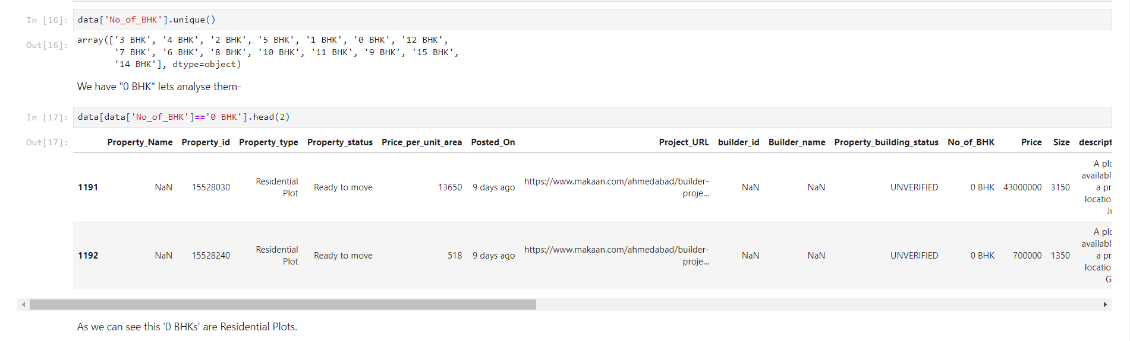
Dropping few rows with RK’s:
“0 BHKs” are Residential Plots:

Slide 7
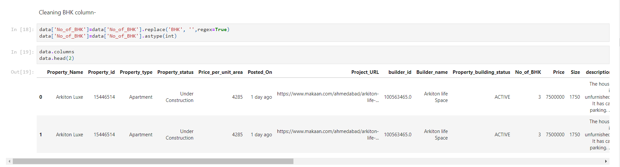
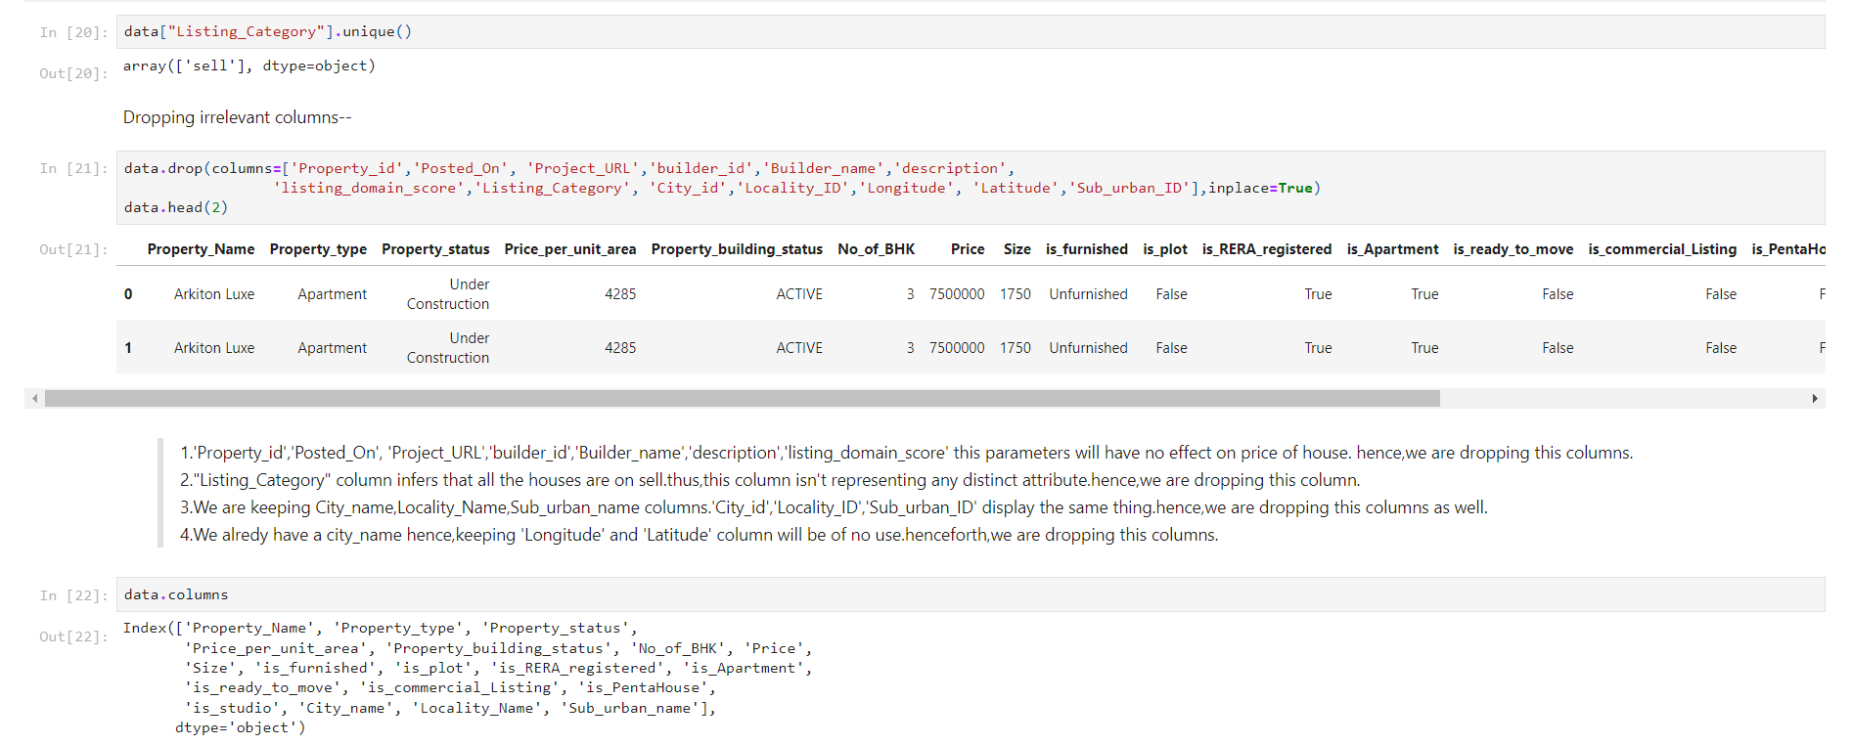
Cleaning BHK column:
Dropping irrelevant columns:

Slide 8
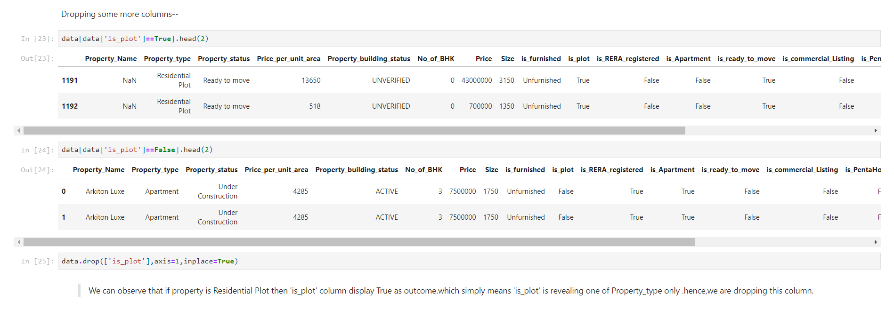
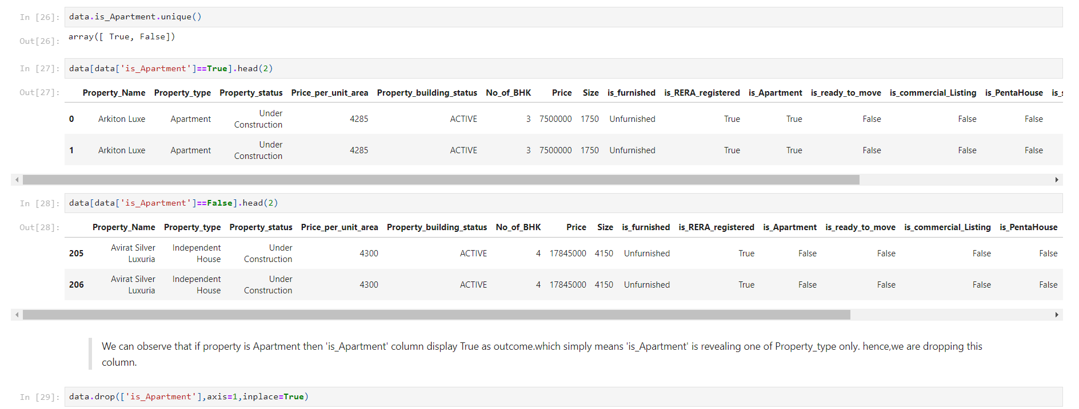
Dropping some more columns:

Slide 9
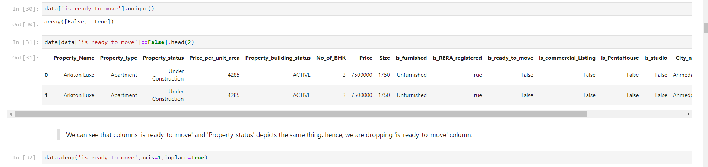
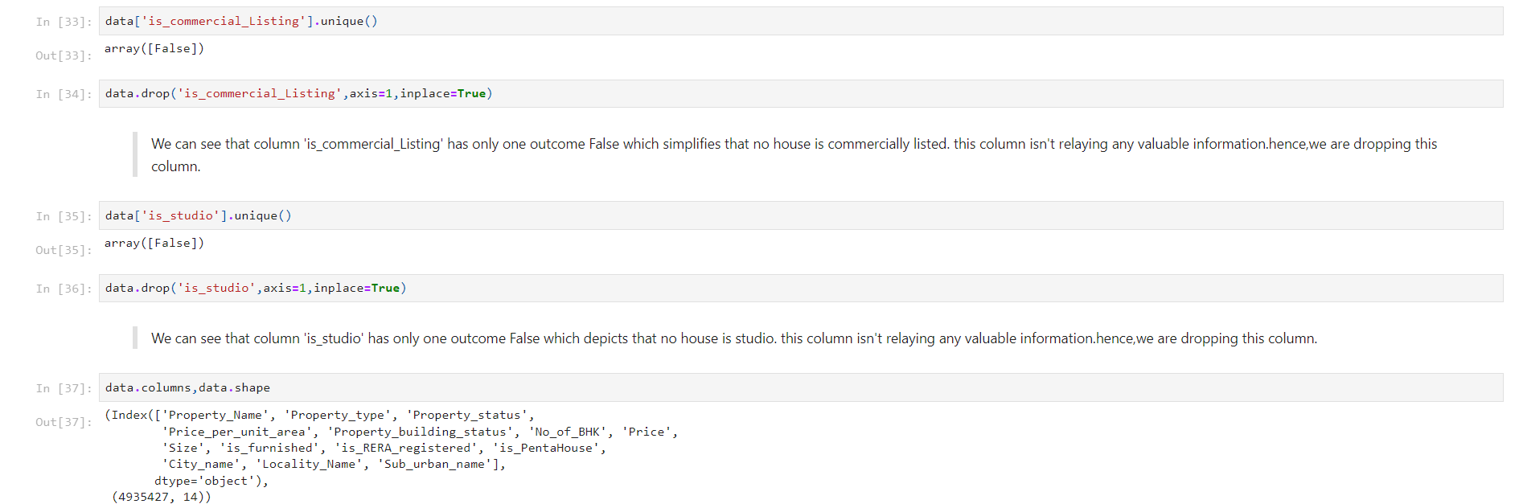

Slide 10
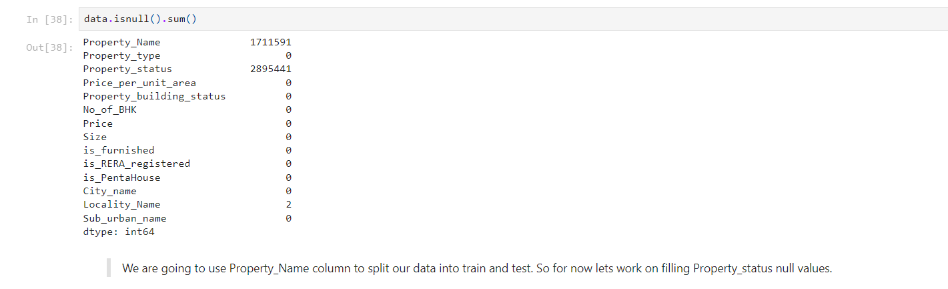
Null Value Treatment - Identifying and imputing missing values.

Slide 11
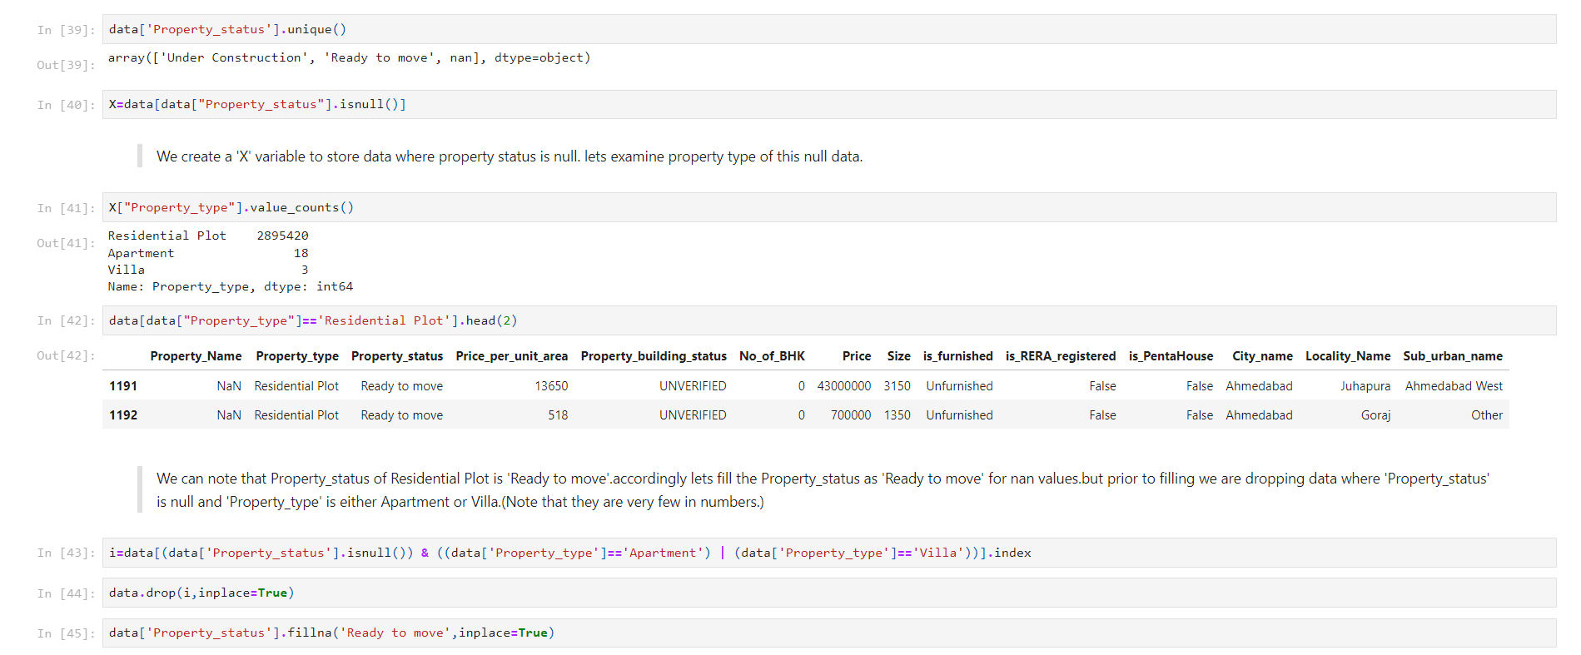
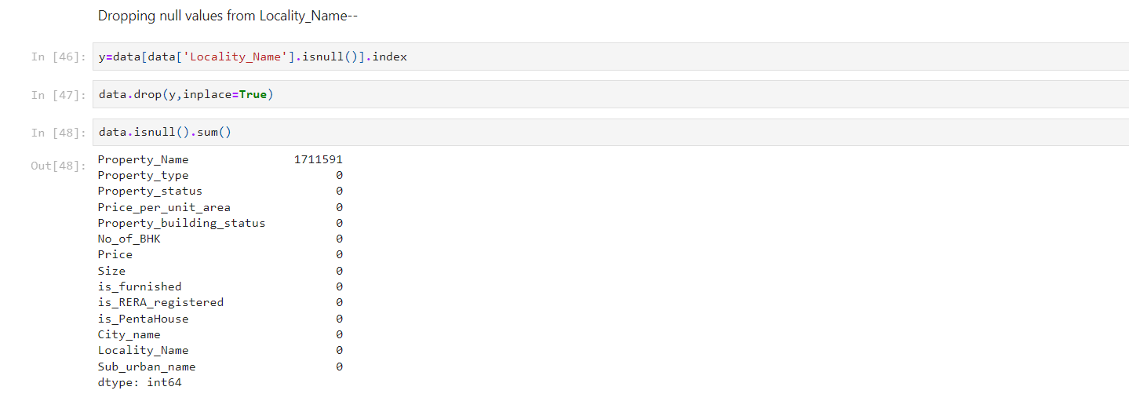

Slide 12
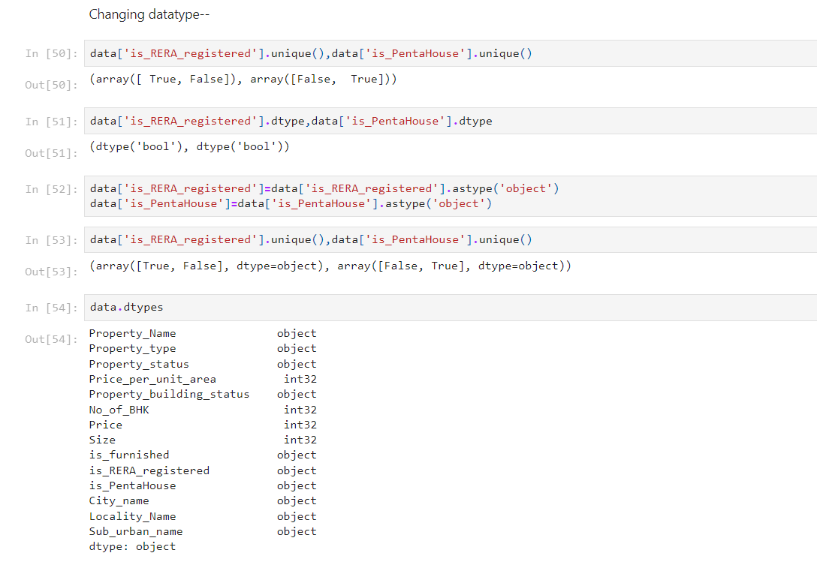
Changing few more datatypes:

Slide 13
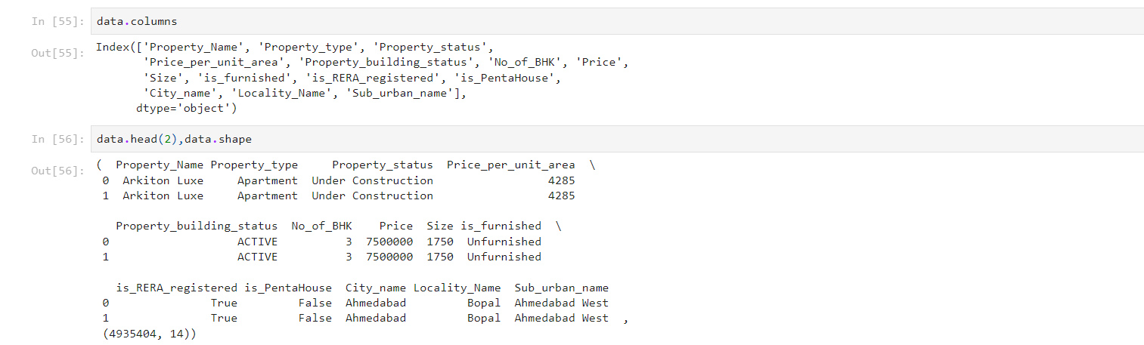
Cleaned Data:

Slide 14
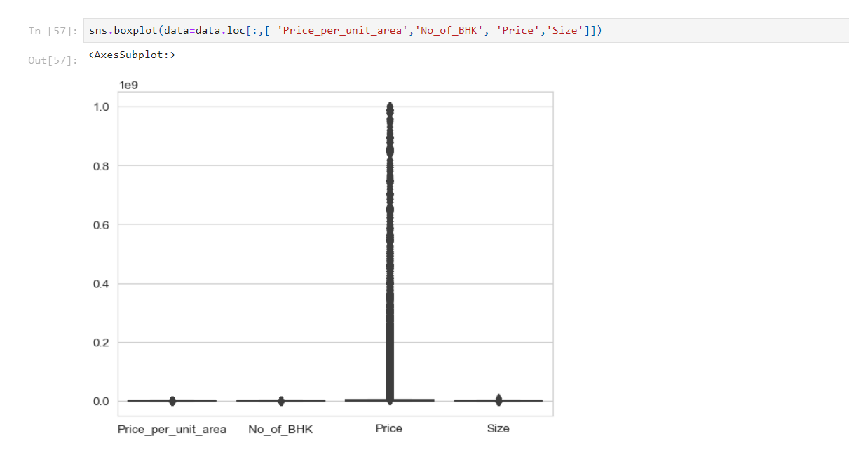
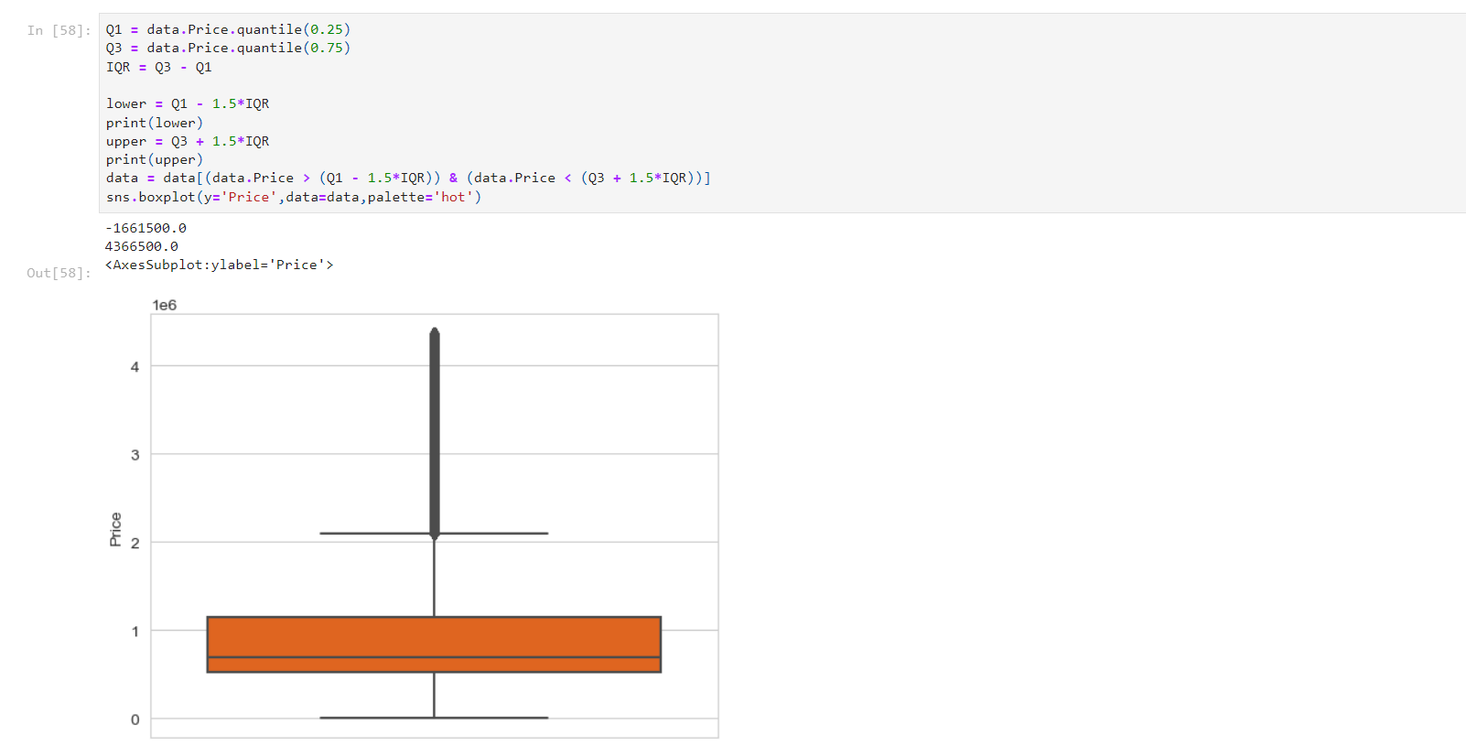
Outlier Treatment: Box plot shows the distribution of the data points by dividing them into different quartiles. Box plot marks lower quartile, median and upper quartile, Any data points which lie outside of the box are treated as outliers.

Slide 15
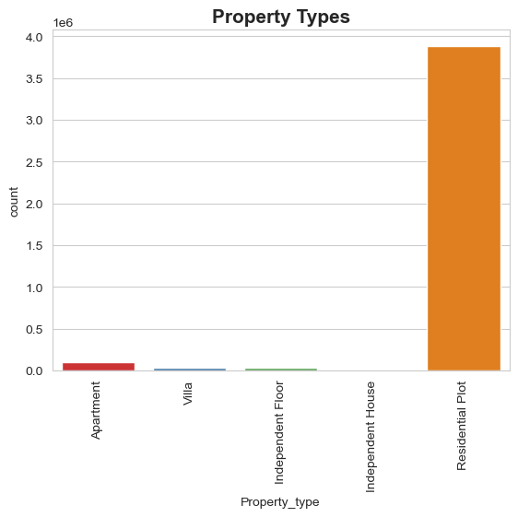
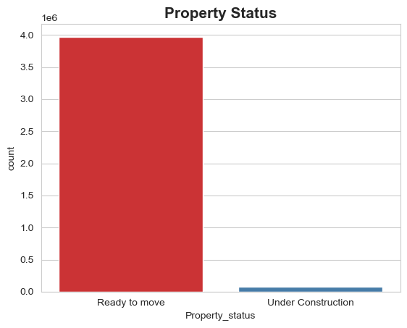
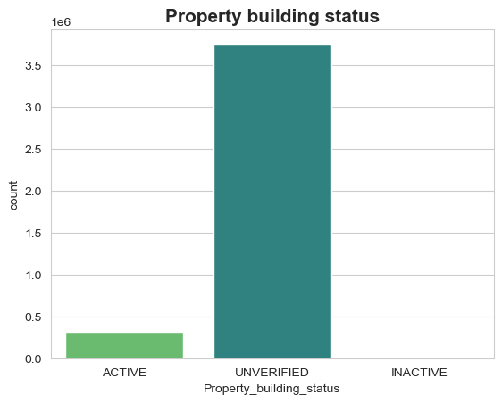
Exploratory Data Analysis:
Mostly property is Residential followed by Apartments.
Most plots are ready to move only Few are under construction.
For most properties building status is unverified.

Slide 16
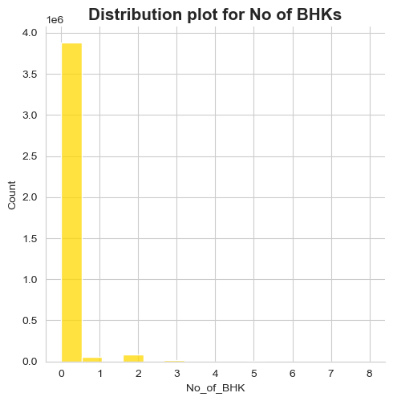
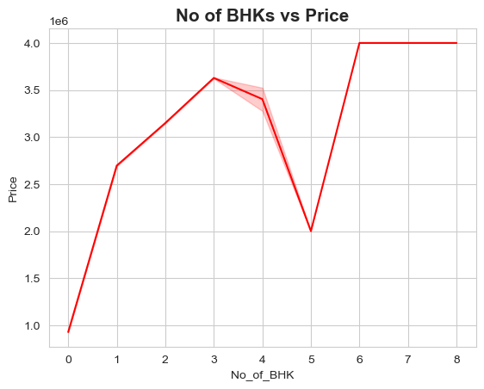
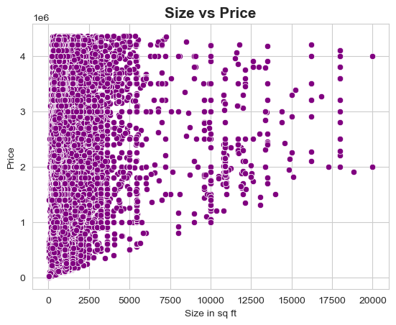
0 BHKs represents Residential plots thus, from above distribution we can conclude that Residential plots are highly available.
As No of BHK increase from 0 to 3 overall price is also rising however, there is fluctuation in price thereupon.
Above scatterplot depicts that Size of property have impact on price.

Slide 17
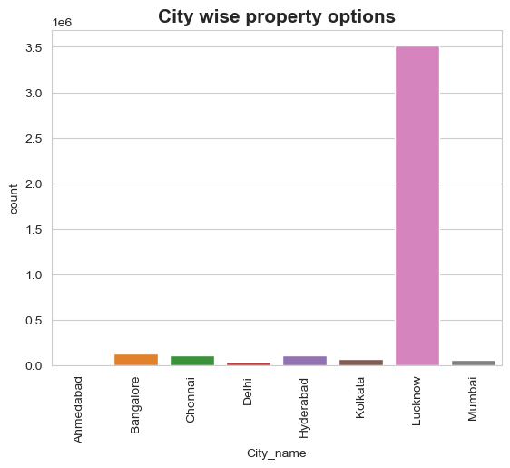
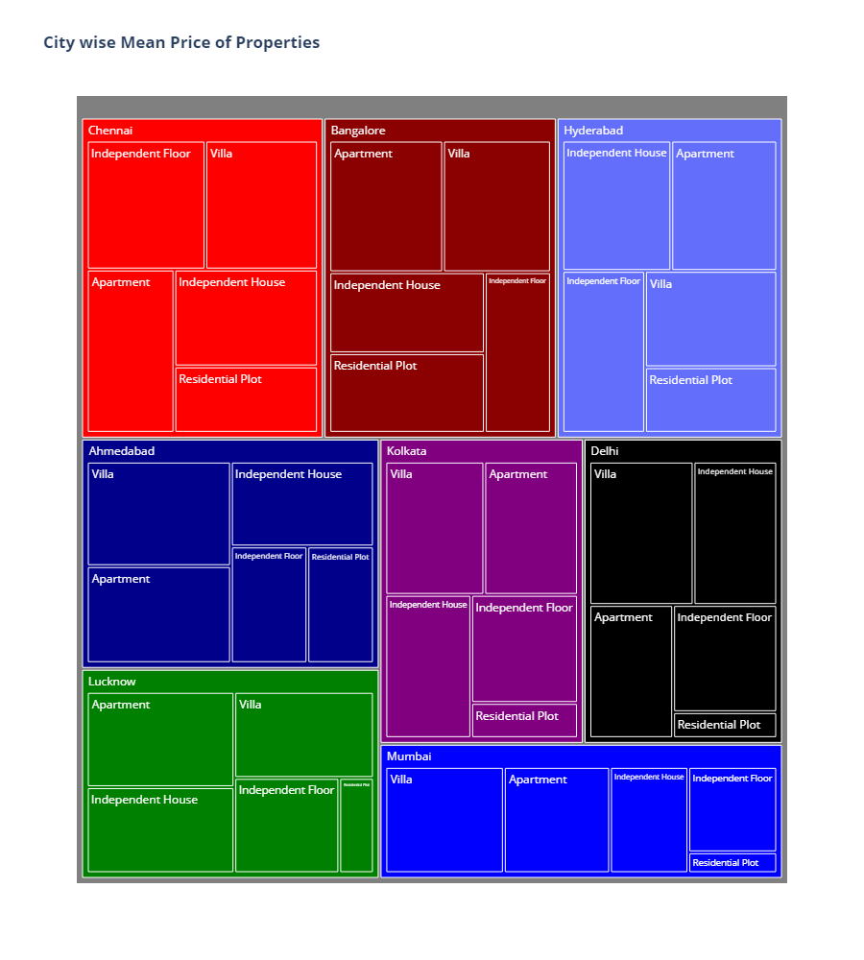
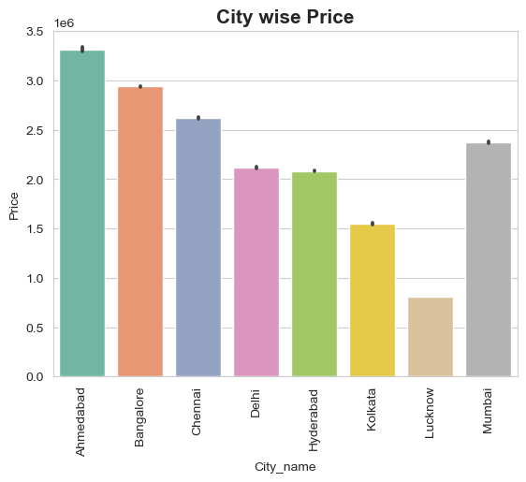
City wise Mean Price of Properties:
1.Lucknow has highest number of property options.
2.Ahmedabad has highest property prices. While Lucknow offers cheaper properties.
3.Independent Floor in Chennai are most expensive whilst Residential plots in Mumbai cheaper among properties.

Slide 18
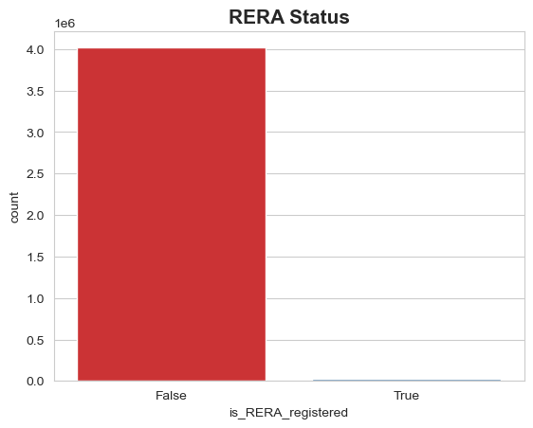
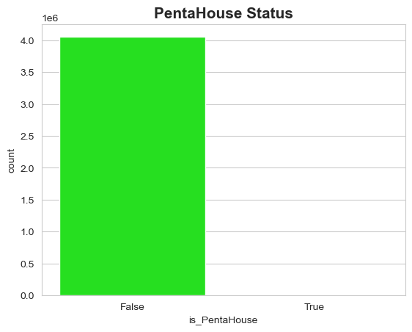
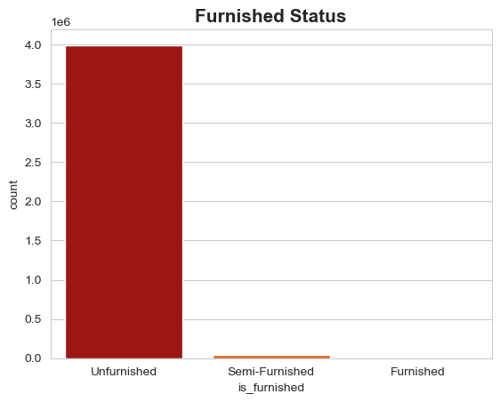
Very few properties are registered under RERA.
Hardly any Pentahouses are available.
Most of the properties are Unfurnished.

Slide 19
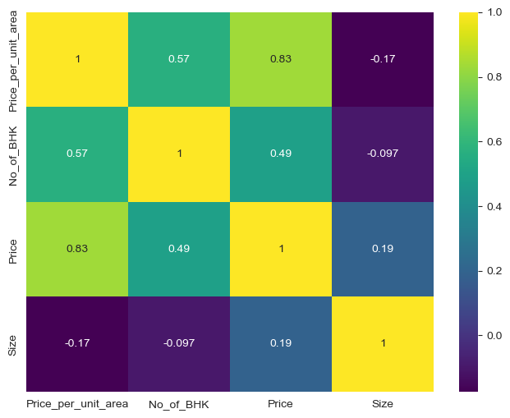
Correlation Matrix Heatmap:
Price and Price_per_unit_area are strongly positively correlated.(r=0.83)
Price and No_of_BHK are moderately positively correlated. (r=0.49)
Price and Size are very weakly positively correlated. (r=0.19)
Size and Price_per_unit_area are very weakly negatively correlated. (r= - 0.17)
Size and No_of_BHK have no association.(r= - 0.097)

Slide 20
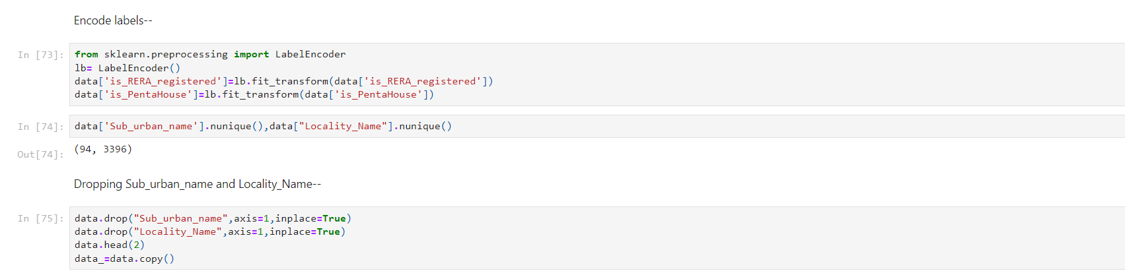
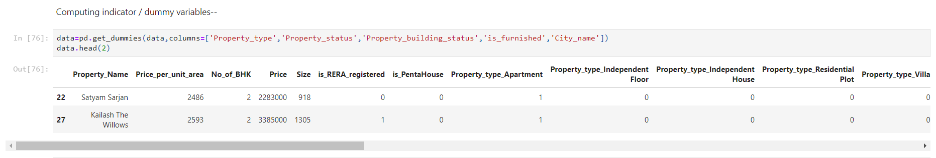
Feature Engineering: Encoding Labels:
Computing Indicator/ Dummy variables:

Slide 21
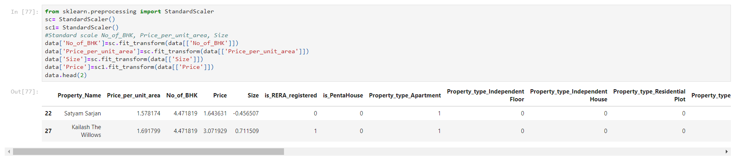
Scaling of data:
Feature Scaling is a technique to standardize the independent features present in the data in a fixed range. It is performed during the data pre-processing to handle highly varying magnitudes or values or units.

Slide 22
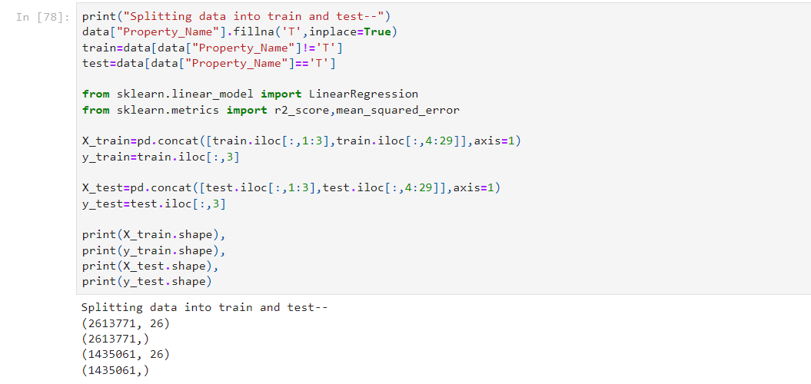
Splitting of data: Property name column have Nan values and this is our test data. We are filling this Nan values with ‘T’ prior to defining it as test data.

Slide 23
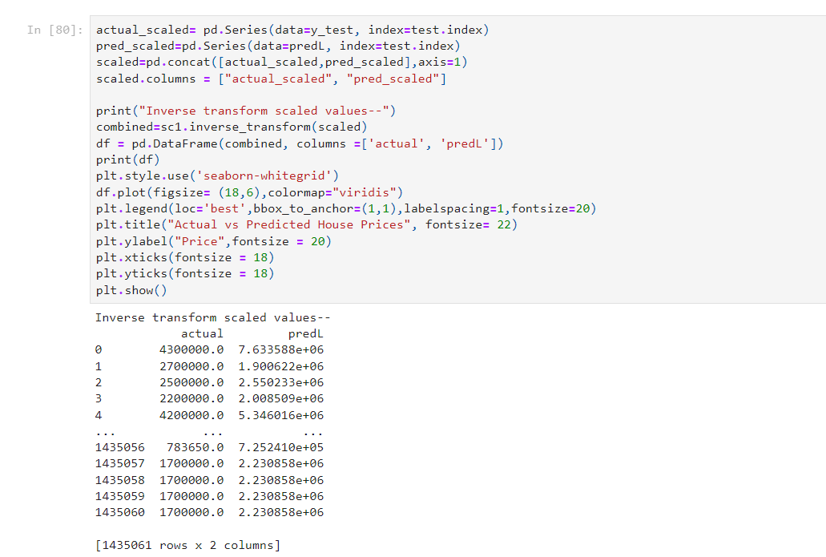
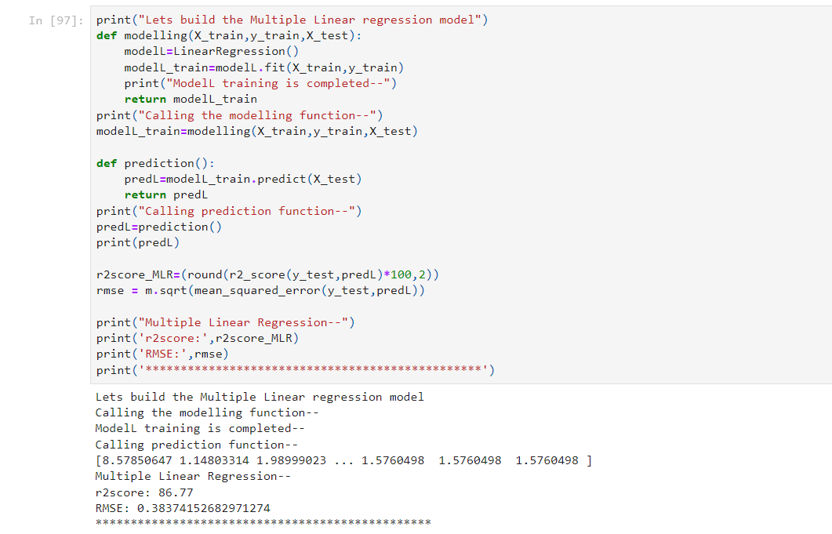
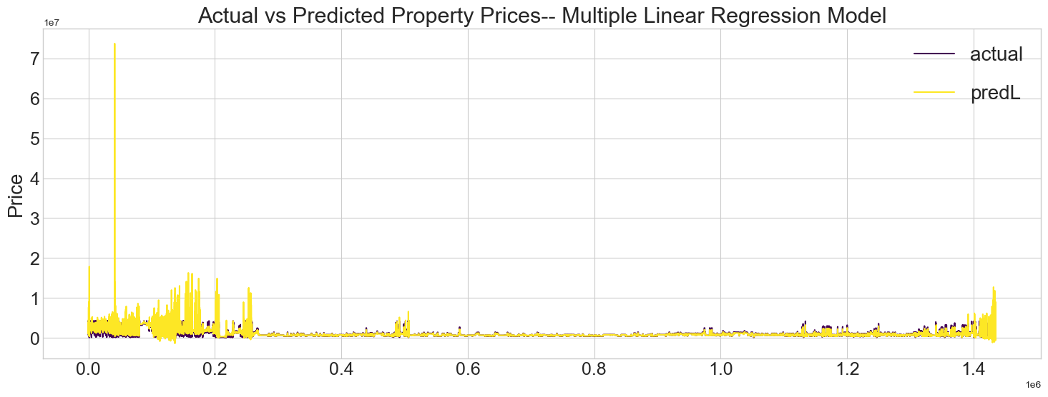
Building of a Model: 1. Multiple Linear Regression:
Inverse transforming Scaled Values:

Slide 24
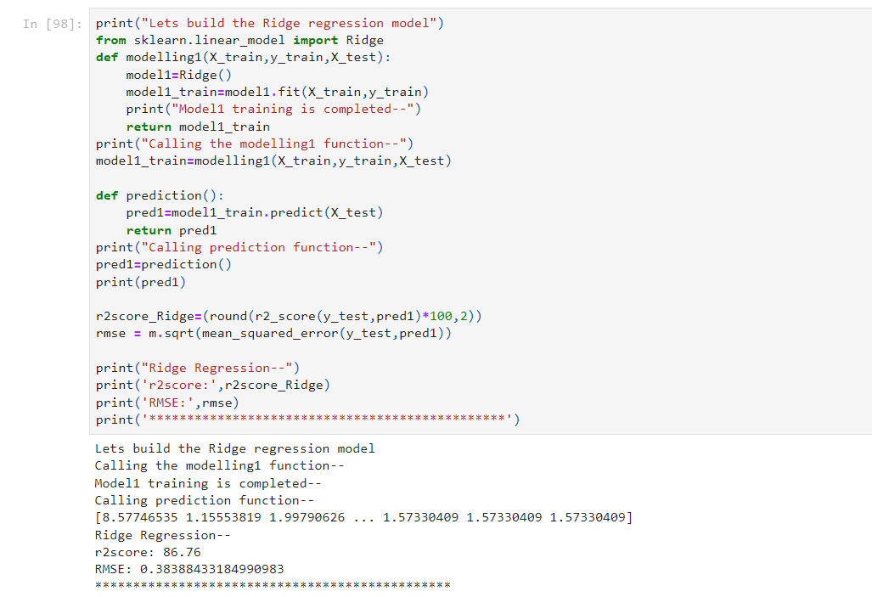
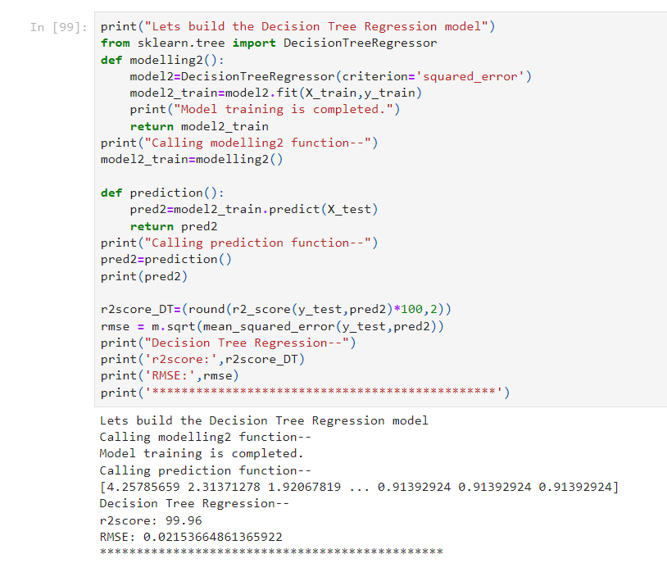
2. Ridge Regression:
3. Decision Tree Regression:

Slide 25
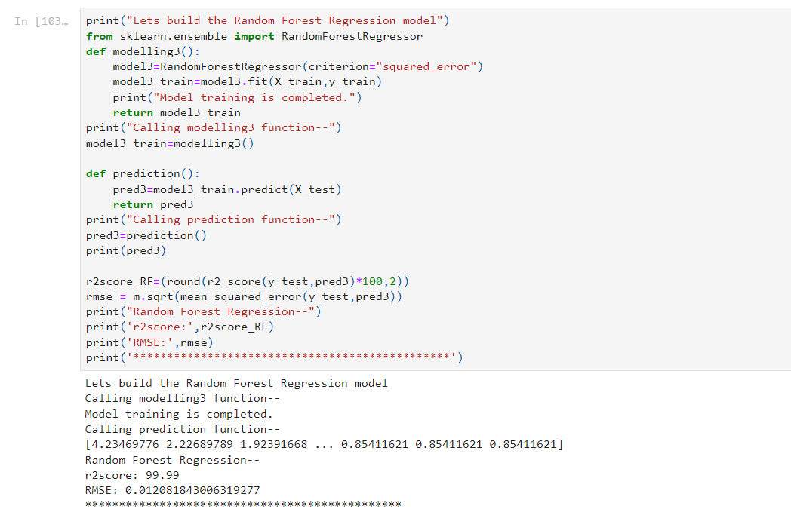
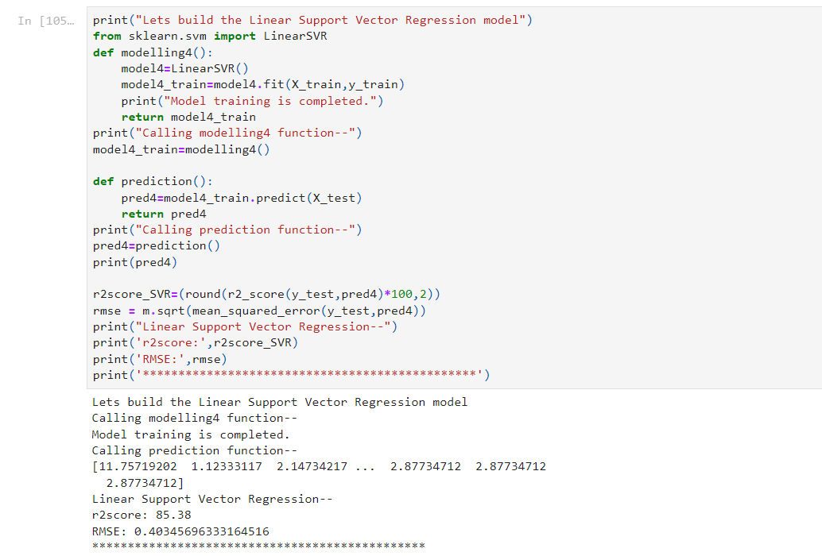
4. Random Forest Regression:
5. Linear Support Vector Regression:

Slide 26
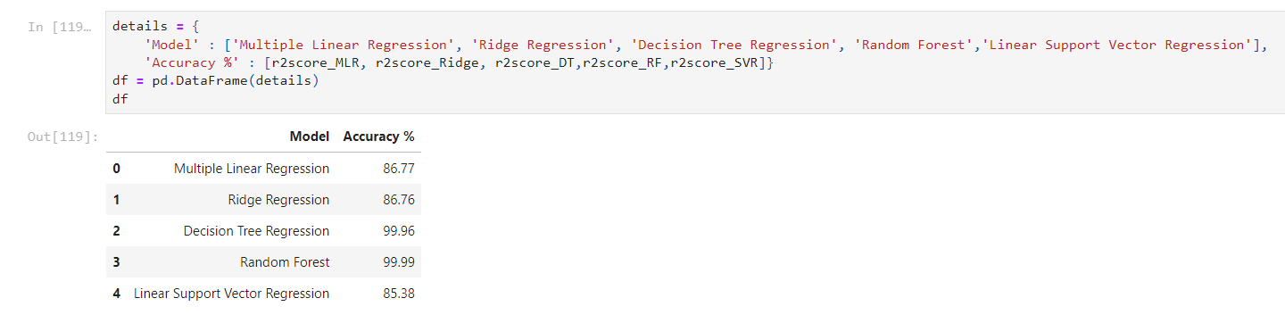
Decision Tree and Random Forest models are giving highest accuracy.
2. Although here we are choosing model with optimum accuracy. We will consider Property prices predicted by Multiple Linear Regression model for our further analysis.

Slide 27
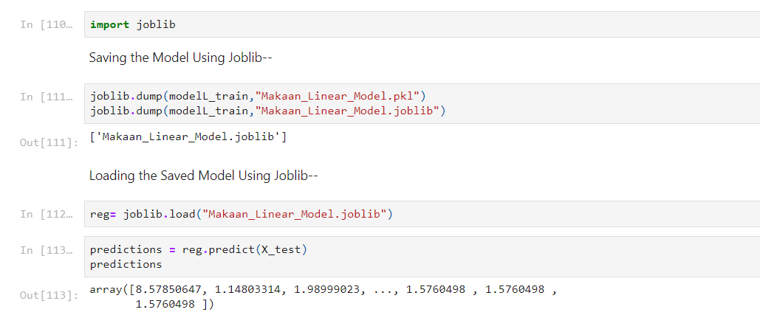
Saving the model using joblib:
We save our model using joblib. Besides we test the model to predict property prices.

Slide 28
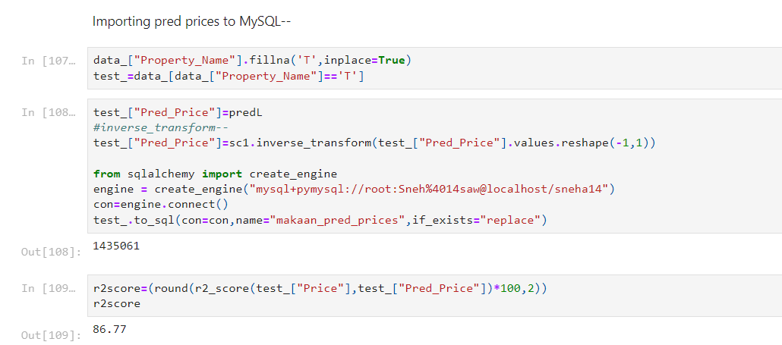
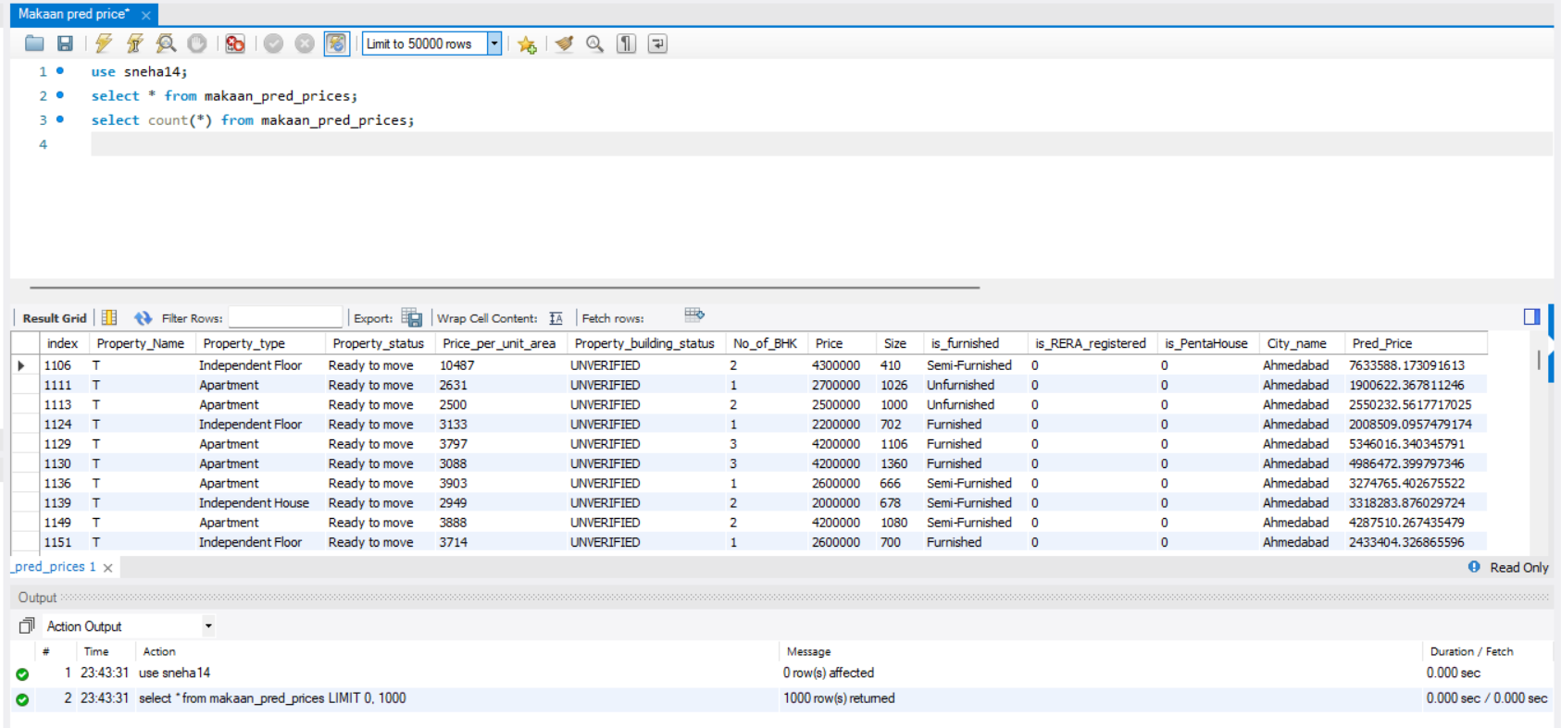
Importing Property prices predicted by Multiple Linear Regression model to MySQL:

Slide 29
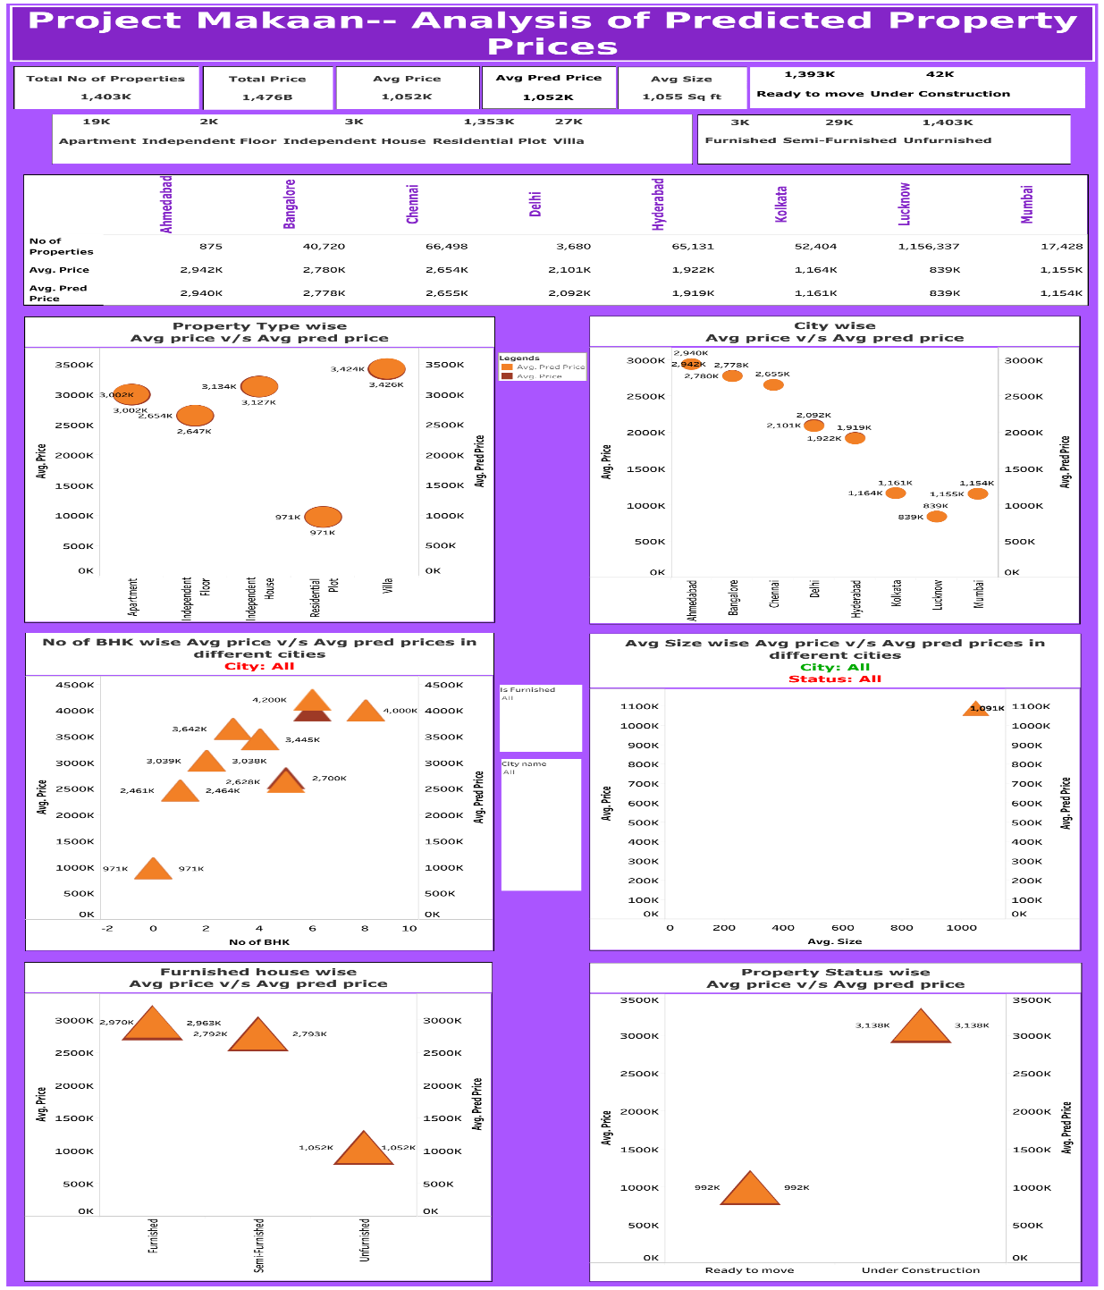
Final Dashboard of predicted house prices prepared Using Tableau:

Slide 30
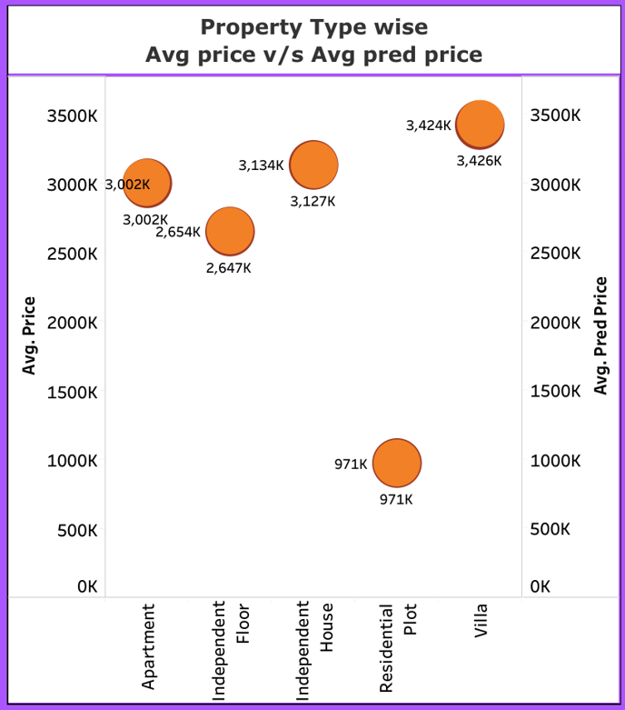
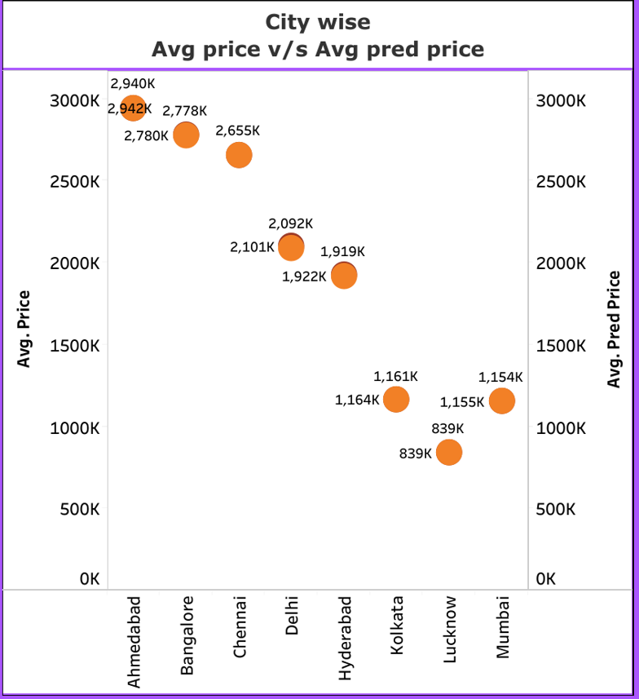
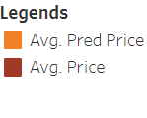
Insights from Dashboard:
Average price of villa’s is high while Residential plots are low-priced.
Property rates are sky-scraping in Ahmedabad city whereas Lucknow city is offering low-priced properties.

Slide 31
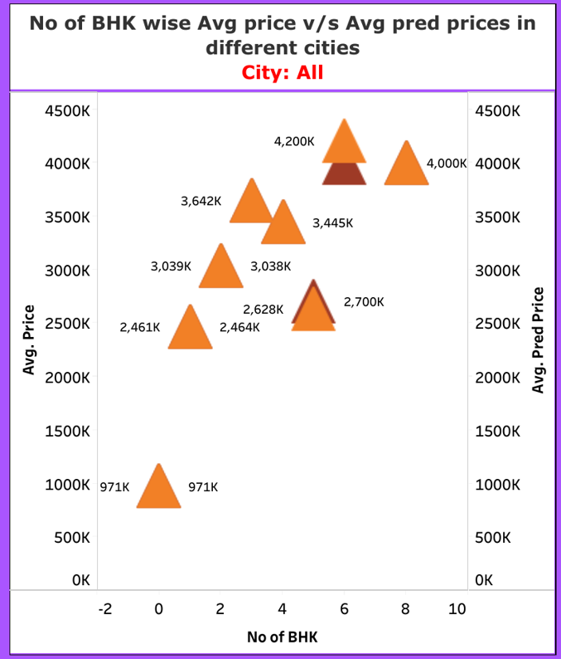
6 and 8 BHKs are expensive whereas 0 BHKs i.e. Residential plots are low-priced.
For 6 BHK Averageg price is 4000k while our model have predicted 4200k.

Slide 32
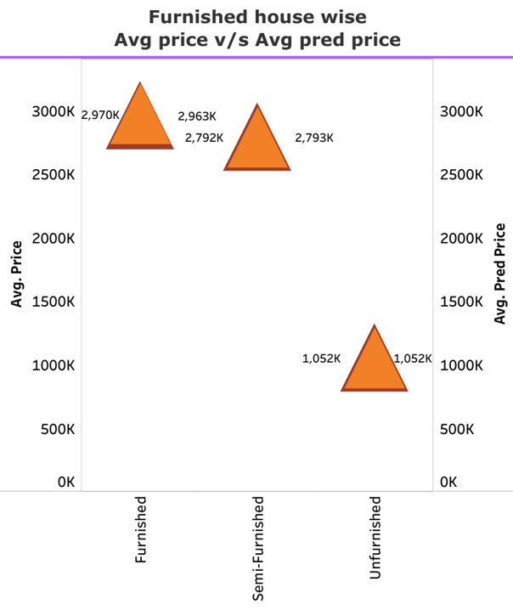

Furnished properties have priced high whereas unfurnished properties are priced low.
Average price of under construction property is high whereas Ready to move properties are offered in low price.

Slide 33
THANK YOU!!!

